Slide 1
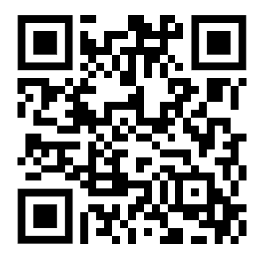
As you come in...
Please fill out a short survey
Via QR code at right
Or by typing the following link into your browser: https://forms.gle/CDBy91qZwVt54ViF9
Responses will be shared anonymously

Slide 2

Writing Intensive Instruction in the Age of Generative AI
A Roundtable Discussion & Workshop
Julie Fiorelli, English
Elissa Weeks Stogner, English
Elizabeth Webster, Criminal Justice and Criminology
Teresa Irene Gonzales, Sociology
Jessica Brown, Multimedia Journalism
Julie Chamberlin, English

Slide 3
Agenda
Answer poll as you come in
Some Observations, Principles, and Guiding Questions (Julie Fiorelli)
Developing and Communicating an AI Policy (Elissa Weeks Stogner)
Ensuring Academic Integrity in the Age of ChatGPT: Proactive & Reactive Strategies (Elizabeth Webster)
Artificial (Un)Intelligence or Aspirational Imagination (Teresa Irene Gonzales)
AI & News Writing (Jessica Brown)
Practical Implementation of AI Policies and Activities: A Workshop (Julie Chamberlin)
Questions, closing thoughts?

Slide 4

Some Observations, Principles, and Guiding Questions
Julie Fiorelli, Writing Across the Curriculum Coordinator; Senior Lecturer, English

Slide 5
Some observed trends in writing-intensive instructor response to GenAI
Range of comfort with and use of GenAI
Concerns about academic dishonesty and potential effects on student writing ability and output
Reduction in reliance on out-of-class writing as means of assessment; more in-class writing
Reconsideration of writing assignments and assumptions about student writing

Slide 6
Some guiding principles about writing
Writing not as an end product, but as a process and a means to learn and think
A fundamental tenet of Writing Across the Curriculum is that writing is a mode of learning. Students develop understanding and insights through the act of writing. Rather than writing simply being a matter of presenting existing information or furnishing products for the purpose of testing or grading, writing is a fundamental means to create deep learning and foster cognitive development. Learning to write within a field or major is also one of the most critical ways that emerging scholars and professionals become enculturated in a discourse community. We are concerned that relying on AI text generators limits student learning and enculturation.
from AWAC, “Statement on Artificial Intelligence Writing Tools in Writing Across the Curriculum Settings,” Jan. 2023

Slide 7
Some guiding principles about writing
Writing as a social practice
Language and writing as playing an important role in social justice, potentially limiting or furthering it

Slide 8
Some questions that might help guide our practice in the writing-intensive classroom
What do we want our students to learn? What kinds of thinking do we want them to engage in? What are the best methods and tools to facilitate this?
How can we make writing assignments meaningful? What genres and modes can enhance student learning and understanding of writing in our disciplines? How can we foster creativity, diversity, and originality in writing?
How can we fully engage students in writing as a process, as a social process?
How can we address challenges around privacy, access, and/or integrity related to generative AI?
How can we advance Loyola’s social justice mission through writing instruction and assessment?

Slide 9
Developing and Communicating an AI Policy
Elissa Weeks Stogner, Writing Placement Assessment Coordinator; Senior Lecturer, English

Slide 10
Developing and Communicating an AI Policy
Understand that AI is pervasive and that students use AI in many ways.
Consider your course and assignment objectives and develop policies that reflect them.
Communicate your policies on your syllabus.
Explain and discuss your policies in class (multiple times).

Slide 11
Ensuring Academic Integrity in the Age of ChatGPT: Proactive & Reactive Strategies
Elizabeth Webster, Associate Professor, Criminal Justice and Criminology

Slide 12
Technologies and Tools
These are the tools I am most familiar with:
AI Tool
  Chat GPT – a Chat Bot available for free online at openai.com/chatgpt
Turnitin AI detection on Sakai
GPTZero, AI detection for educators
  See also ZeroGPT, Quillbot and more
Notes:
See ZeroGPT “text paraphraser” tool that students could also be using to plagiarize.

Slide 13
Proactive Strategies
How to ChatGPT – proof assignments
Address student use of AI on your syllabus
Use Chat GPT to provide a sample response
Require them to submit written assignments in stages
  Ex: proposal, outline, rough draft
Build in a presentation or oral exam component
Notes:
First make sure that they know that using ChatGPT and paraphrase tools will be considered cheating and what the consequences will be.
Example of the debate assignment and how you used ChatGPT to share template responses and then challenged them to surpass that. You could also workshop these responses and have students suggest revisions to add creativity
Example of how presentations can help them prepare for the writing part and also help detect plagiarism or lack of preparation

Slide 14
Reactive Strategies
How to Address Potential Plagiarism
Turnitin AI detection rate of less than 20% is not reliable
For reports over 20%
  Check against a different AI detection tool (e.g. GPTZero)
  Share with students the Turnitin AI detection report
  Have a conversation about how to avoid formulaic writing
  If you discover plagiarism:
    Require them to re-do the assignment(s)
Notes:
Be sure that they know when they have set off alarms in Turnitin and have a conversation about it. Most often they are not using AI, but they may be writing in a really formulaic style. Show them how to write like a human and not a chatbot. How does AI software detection work? (You can disable the AI report if you don’t want that feature.)
What are the features of the writing that triggers Turnitin? “lacks flavor” predictable. Sounds like ChatGPT or ChatGPT Plus (these are the AI tools that Turnitin AI detection is primed to discover).
One student who did admit to plagiarizing submitted a paper with 100% AI match. Others who did not, and did not even know what Chat GPT was, have received 33% and 75% scores. Using in-text citations does not save students from an AI match. They say that they have less than a 1% false positive rate and that they err on the side of false negatives. But if it’s less than 20% they admit there’s a higher rate of false positives, so I would never confront a student about less then 20%. In Turnitin, students do not have the option of viewing the AI detection report. However, you can download and send to them.
You will want to check the writing against another detection system such as GPTZero, which is trained on AI tools I’ve never heard of (not just ChatGPT). However, it may have a higher rate of false negatives. I have plugged in content generated in ChatGPT and then run through a paraphrase tool and it didn’t detect it as AI generated content (36%). So there is no one definitive source or absolute result that you can trust.
What has AI flagged of my student’s writing: grammatically correct and well organized, but repetitive, explanatory and Wikipedia-style writing. One of the features of AI detection software is that it looks at segments of text to detect the predictability of the sentences that follow each other. Human writing is usually less predictable, but students who have been trained to write organized paragraphs may also write this way. You can use these tools to initiate an individual conversation with them about the strengths and weaknesses of their writing style

Slide 15
Artificial (Un)Intelligence or "Abundant Imagination"
Teresa Irene Gonzales, Assistant Professor, Sociology

Slide 16

Un-Intelligent AI
Discuss the limitations of un-intelligent AI that replicates inequality and social injustices.
Much of AI is created by a very small subset of the population, and much of the labor used to expand it is outsourced to areas with exploitative practices (see: Dr. Ruha Benjamin)
As a result, AI outputs center dominant languages and language practices, epistemologies, cultures and cultural ways of knowing, and solutions.
This can limit our students' imaginations, future problem-solving, and critical thinking skills.

Slide 17
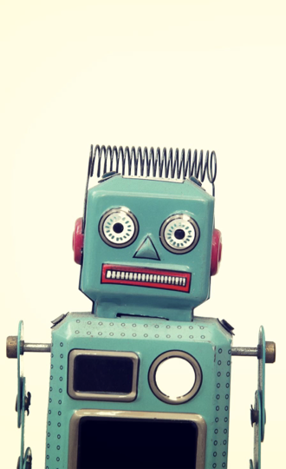
(A)bundant (I)magination
Move the conversation from scary AI to getting silly with what Ruha Benjamin terms "abundant imagination."
What might this mean in the classroom?
  Disrupt normative ways of thinking about social issues.
    Cultivate a classroom culture of dreaming and possibility
  Gamify assignments and classroom activities.
  Get creative with assignments that allow for imagination (op-eds in the Phoenix, purposefully use AI—ChatGPT or Dall-E—to demonstrate limitations, group projects focused on multidisciplinary and multi-modal parts)
  Read Ruha Benjamin’s book “Imagination a Manifesto.”

Slide 18
AI & News Writing
Jessica Brown, Senior Professional in Residence, Multimedia Journalism

Slide 19
QUESTION:
How can journalism students use AI to write better stories?
Before we answer this question....

Slide 20
Let's explain how news writing is different from other forms of writing and why this matters:
  Structure
  AP Style
  Cadence
  Sourcing
  Differences are harder to replicate
So, let's move on to our main points >

Slide 21
ONE:
Students are already using AI and have been for decades:
Spell check & grammar check
Grammarly, etc.
But Generative AI is different and more powerful

Slide 22
TWO:
Today’s students risk using AI to generate entire news stories, but what are the obvious pitfalls?
Fact errors
Editorialization
Hyperbole
AP style errors
Let's take a look >

Slide 23
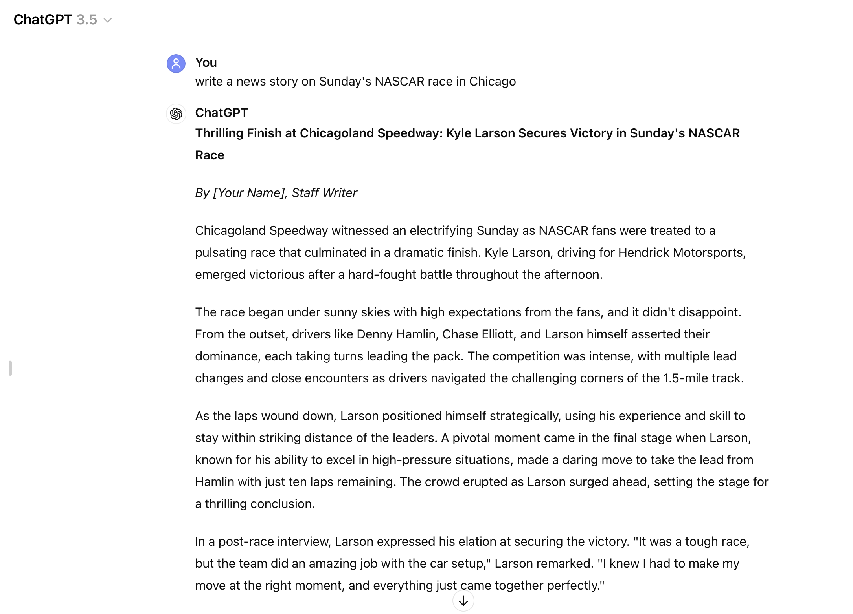
Fact errors
Editorialization
Hyperbole
AP style errors

Slide 24
THREE: WHAT DOES THIS MEAN?
AI is poor at meeting the basic tenets of news writing, thus can be more easily spotted than other genres like essay, academic, persuasive, or business writing.
It wastes time: Fact checking, AP Style; General Sentence Construction (remember news writing is different)
It does do a decent job of writing broadcast ledes, why?

Slide 25
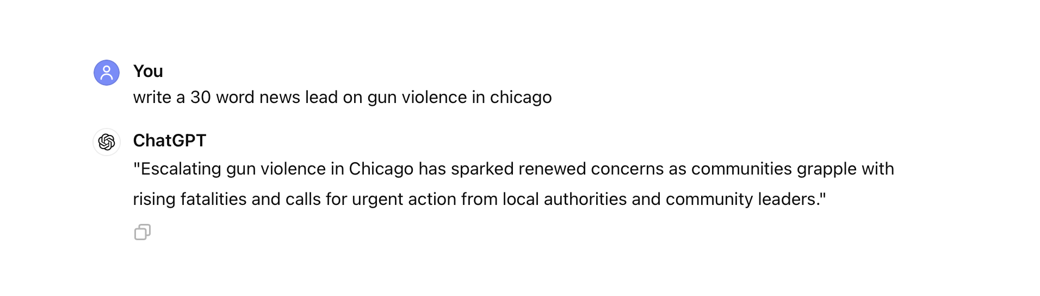
THREE: continued...
It does do a decent job of writing broadcast ledes, why?

Slide 26
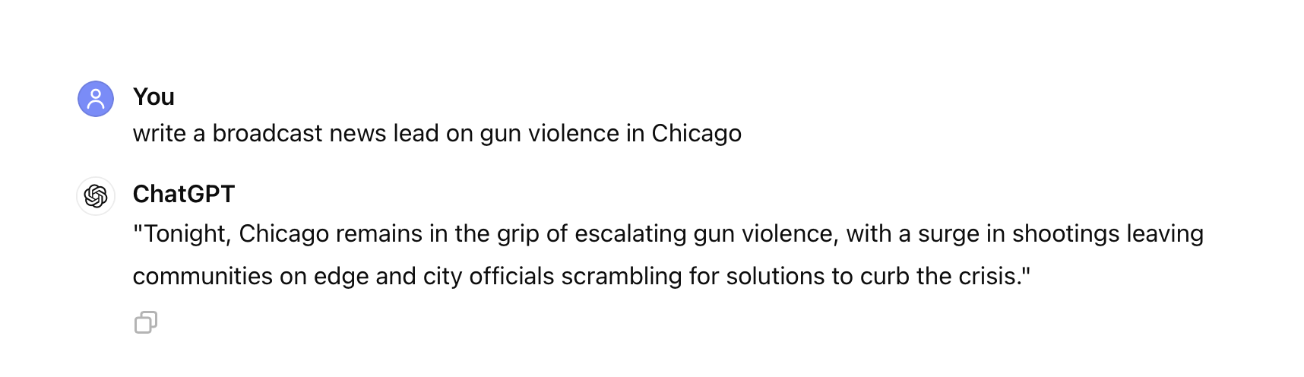
This is a broadcast lede. It's harder to spot

Slide 27
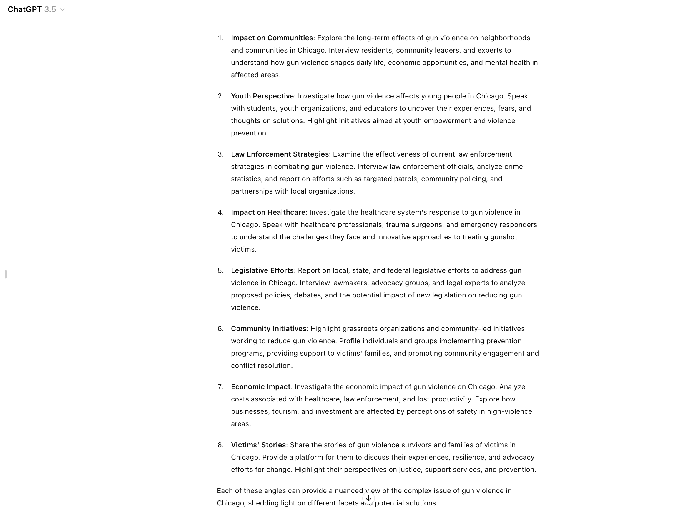
FOUR: USING AI ETHICALLY
Idea Generation​
PROMPT - "Give me news story ideas on gun violence in Chicago"
Use as a teaching tool for bad v. good writing – just like a textbook

Slide 28
FIVE: INOCULATION STRATEGIES
  For introductory courses use textbook or “fake” details to practice writing >
    Build muscle memory & confidence
  Verification of identity of sources (human & digital)
    Ethical muscle memory
    Real-world expectations

Slide 29
FIVE: INOCULATION STRATEGIES
  Emphasis examples of AI gone wrong
    Sports Illustrated
    Gannett
  Emphasis learning & Jesuit values
    Why are you here?
    Don't spend six figures just to cheat

Slide 30
Before we leave...
The More you Know:
I used nearly 16 oz. of water to generate the prompts in this slide. I hope IES is presenting on AI this year!
THANK
YOU!

Slide 31
Practical Implementation of AI Policies & Activities: A Workshop
Julie Chamberlin, FCIP Faculty Scholar in Assignment Design (2023-4); Advanced Lecturer, English

Slide 32
Practical Implementation
(disciplinary differences)
Business Writing
First-Year Writing
Students are allowed to use AI tools on assignments as they see fit, however...
Assignment prompts present sensitive and complex professional scenarios for students to navigate in writing
Students are assessed on rhetorical effectiveness and strategy
In-class activities encourage students to critique AI writing and discuss its potential utility and pitfalls
My syllabi explicitly disallows any type of AI use, including Grammarly. This policy is reinforced by...
Giving students time to write and workshop in class,
Building "remediation" into assignment scaffolding (e.g. Podcast to Research Essay to In-Class Presentation),
Using in-class activities to critique AI writing and openly discuss what makes researchers responsible for what they write (and cite!).

Slide 33
Example Assignments
Business Writing
First-Year Writing
You are an administrative assistant writing on behalf of ChiTown Solutions' president, informing candidates whether they have been chosen as a finalist for ChiTown Solutions' exclusive internship opportunity.
Write two separate letters to the candidate, one informing him that he has not been selected, and another letting him know he is a finalist and instructing him on how to schedule an interview with the company's president.
Compose a script for a 5-10 minute research podcast on your topic and record it.
Your job is to describe the scholarly conversation and points of debate surrounding your particular topic.
Write your script for an audience of your peers who want quick, credible, and well-supported information on the topic.

Slide 34
Example Activities
Business Writing
First-Year Writing
Students find job advertisements in groups
Individual students then prompt ChatGPT to write a cover letter for that job posting on their behalf & upload to Sakai
I take volunteers to explain what ChatGPT got right and what the AI got wrong about them personally, and how AI voice differs from their own
We discuss as a class why AI, like cover letter templates, can help those inexperienced with the genre, but are rhetorically insufficient
Divide students into 4 groups
Each group receives an example essay, which they are instructed to critique and assess as a group
Three essays are student-written (and of varying, but passable, quality)
One essay is entirely AI-written
The class comes together, and each group is responsible for critiquing their essay
N.B.: The class invariably agrees the AI-written essay is least effective. We discuss why.

Slide 35
Survey Questions / Share Results
How confident do you feel in your knowledge of AI technology?
How big of an issue has AI become in your classroom?
How clearly are AI policies communicated to your students (or to you!)?
To what extent have you integrated AI into assignments & activities?
Do you feel that students can use AI in your writing class and meet the learning objectives?
How supported do you feel as a faculty member dealing with AI?

Slide 36
Workshop
Return to the survey and proceed to the next section
Journal in response to the question for 5 minutes
  Don't submit yet!!!!
After 5 minutes, discuss with a partner for an additional 5 minutes
  Submit!
We will open discussion for sharing what you wrote in the survey or for general questions
Survey results will be shared with participants anonymously.

Slide 37
Workshop Prompt
Think of an assignment/ assignment revision or policy that you could use in your class(es) that addresses generative AI.
For example, this may be the integration of AI into an assignment or classroom demonstration, your class AI policy, or an assignment that is difficult for a bot to complete.
If you prefer to handwrite your response, we encourage you to give your suggestions to the presenters after the session so that we may include them in the resource.

Slide 38
Resources
Working Papers from the MLA-CCCC Joint Taskforce on Writing and AI (and other related resources)
AI Text Generators and Teaching Writing: Starting Points for Inquiry (from AWAC)
Annotated Bibliography: Assignment Design for Academic Integrity (From FCIP)
FCIP Video Resources on AI
Human-Centered Teaching in the Age of AI
  A SOTL podcast episode featuring Julie Chamberlin (English) and Michael Burns (Biology)
Ruha Benjamin, "Imagination A Manifesto"
  Norton Shorts Speaker Series Talk
  Book

